Slide 1
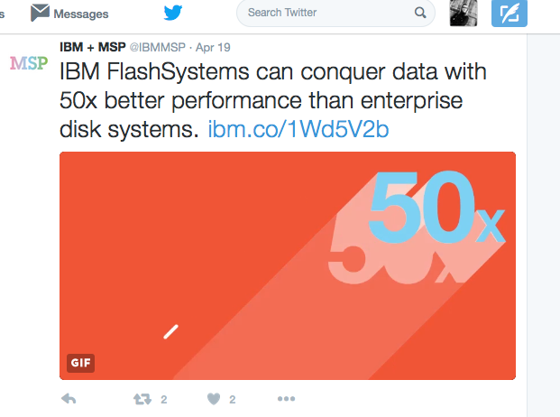
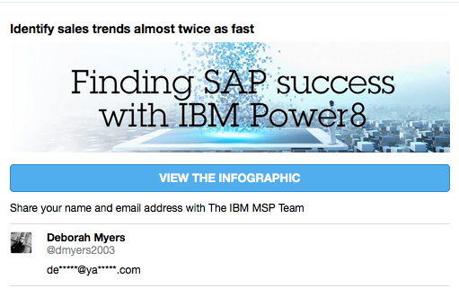
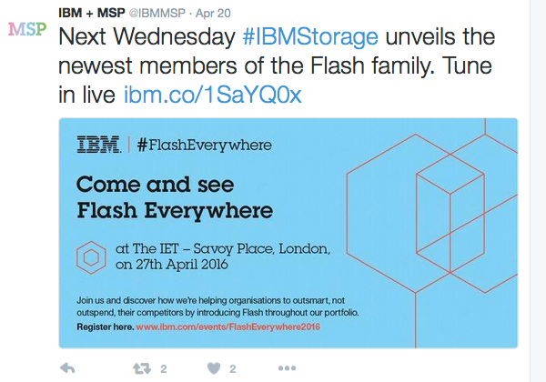
CSP/ISV Systems 2016 BU Campaigns
Campaigns Available – Build, Manage, Secure Infrastructure
MSP/CSP FlashSystem full campaign (Q1, Q2 NA & Europe) – April 27 launch content
MSP/CSP Power Systems Digital Power8 campaign (Q1 NA, Europe)
MSP/CSP SAP/PowerSystems campaign (Q2 Europe)
Campaign Insights
WW: content is digital focused, top of the funnel (Twitter, LI, On channel / Gaggle tool); great reach/response – challenge is in conversion
  Europe: 2 campaigns per segment per quarter / Q2 are both Systems targeting 33K partners in the CSP/ISV segment
  NA: Systems coverage is in Paid Media, Webcast/Events, Paid Search – expected VLRC $2.6M; WR $144K/and support of sales plays: Power hosting for iSeries ISVs WR $169K
Campaign Results:
WW YTD – VLRC $71.1M, 86 wins, WR $30.5M (Open Pipeline $223.5M less than 45 days)
NA – VLRC $27.7M (last year $1.8M); WR $17.3M;
  Storage Q1 – created 2,416,284 impressions / 12,299 clicks
Europe – VLRC $14.8M (last year $100K); WR $500K
  Storage Q1 – created 7009 visits; 85 leads; 1 win so far

